Slide 1
Experiment – 1
PRN : 25070521165
1.1.2 Area of Rectangle
Algorithm
STEP 1 : Start
STEP 2 : Input length, breath
STEP 3 : Calculate
area = length*breath
STEP 4 : Print area
STEP 5 : Stop
Flowchart
Start
Input length, breath
area = length * breath
Print area
Stop

Slide 2
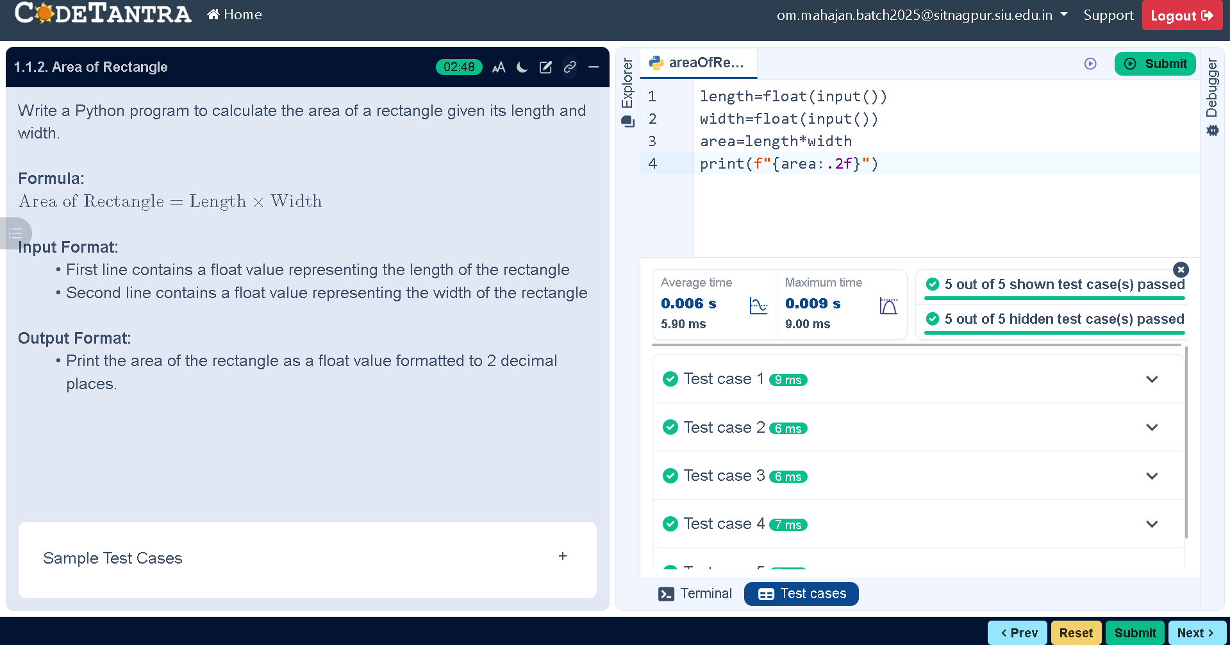
Code
PRN : 25070521165
length = float(input())
breath = float(input())
area = length*breath
print(f"{area:.2f}")
Execution

